Slide 1
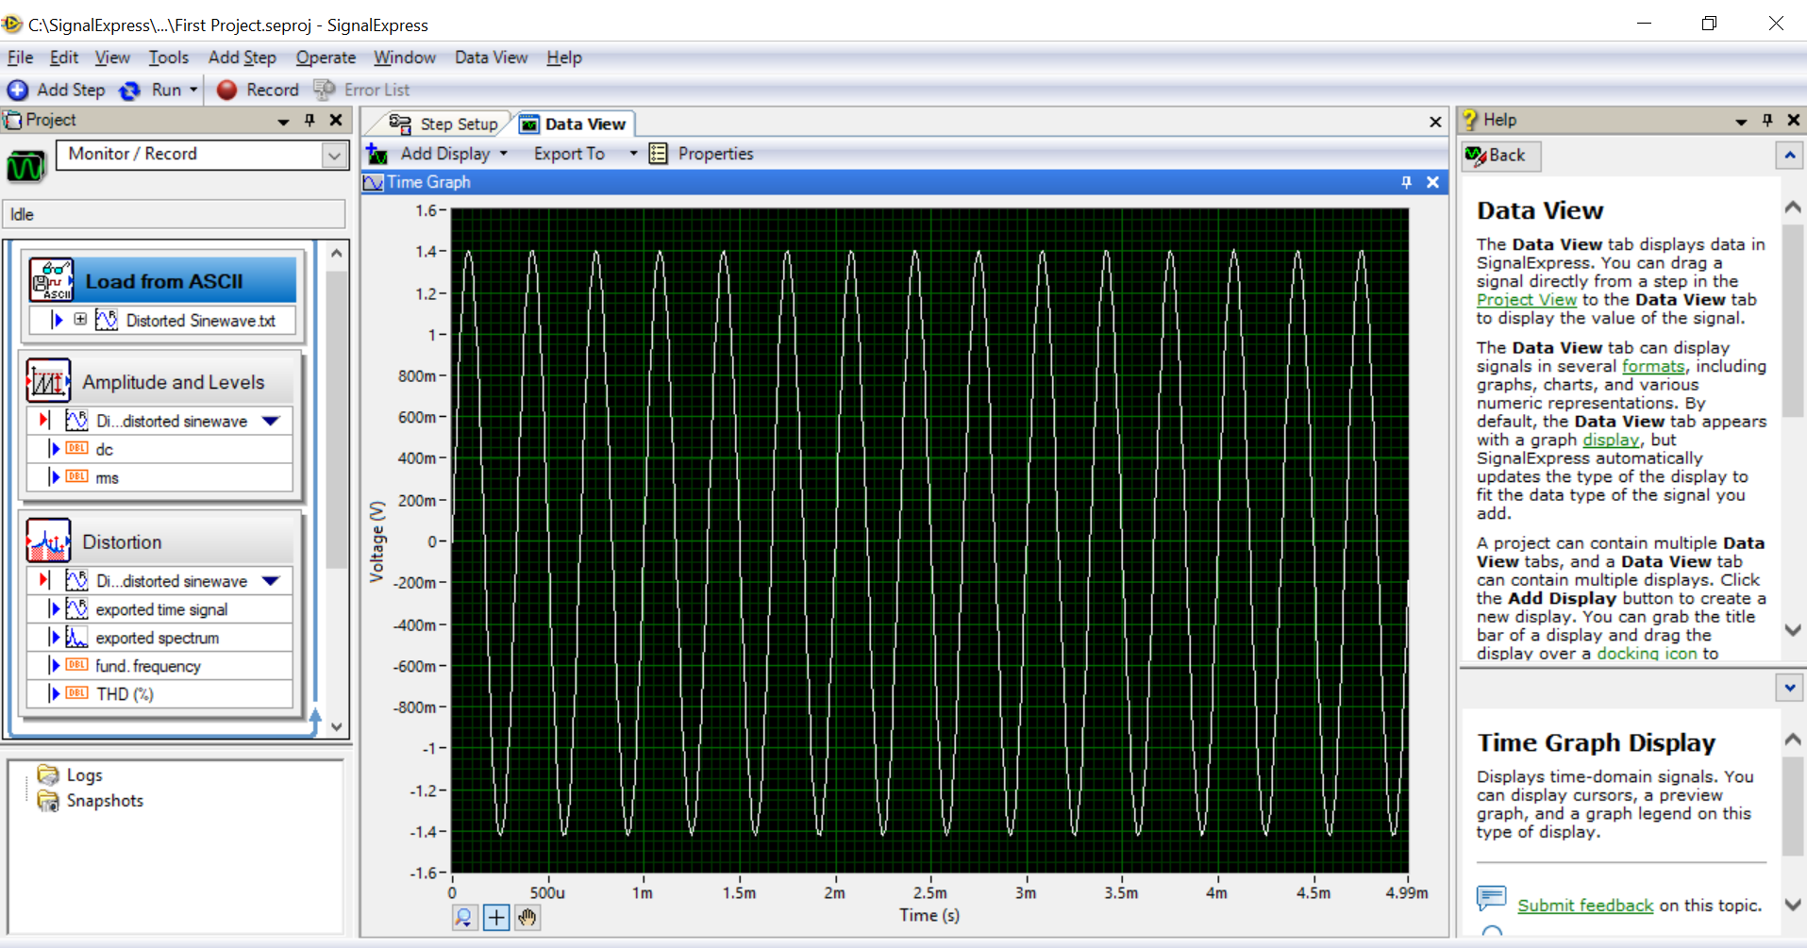
Using signal express
Opening a project
Launch signal express
Select empty signalexpress Project
Examine the window

Slide 2
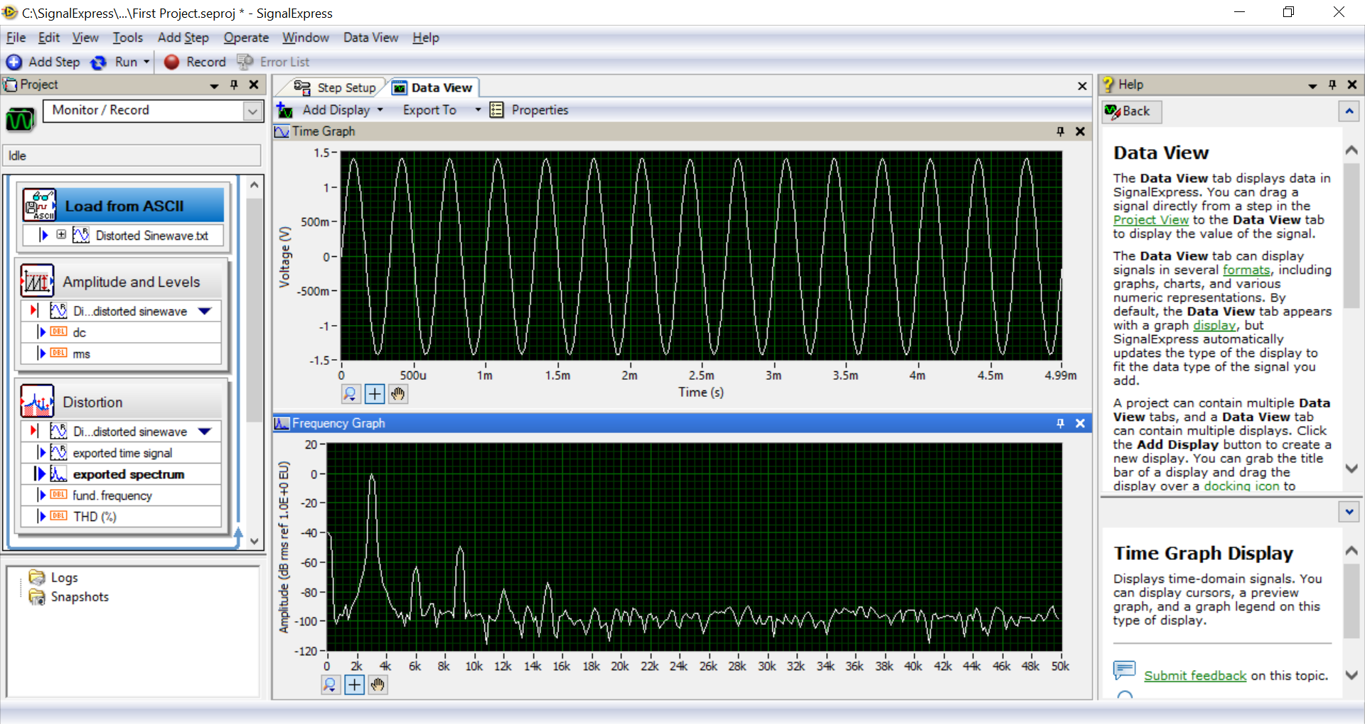
Using signal express
Important steps
Run
stop
Check data view: drag the exported spectrum output signal to dataview from project view.
Can drag other signals as well

Slide 3
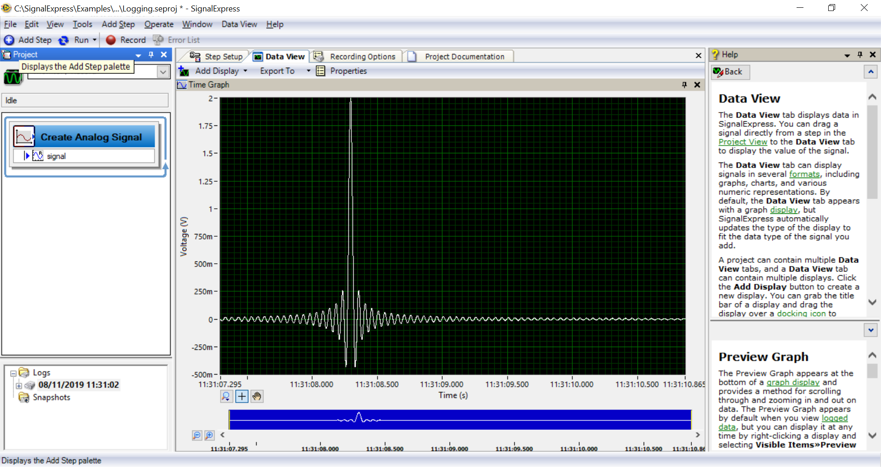
Using signal express
Recording a signal and viewing
Select help-openexample-tutorial-Logging.seproj
Click record buttom to display Logging signals selection dialog box
Place checkmark in the signal
Click ok to close
Click stop (the logged data appear in project view)
Select Tools-Options and select logging option to specify the directory for signal express to save the logged data
Click ok to close options dialog box
Select File-Save Project As
Select the data log you recorded from the logged data window and drag to data view to view
Use export option to get data in excel file

